Slide 1

Warrenbound
By team: Lucky Feet

Slide 2
Pitch
The land has been ravaged by human construction, forcing a herd of rabbits to flee and seek sanctuary. Their only hope of finding a new home lies in their guide from above, the rabbit deity. In this top down stealth/RTS hybrid direct the rabbits, create distractions, and use the terrain to your advantage to keep your followers away from an early grave.

Slide 3
Gameplay
Control multiple rabbits and lead them through the woods
Choose to either sneak or run past predators
Use powers to distract predators
Beware: to much excitement could lead to chaos

Slide 4
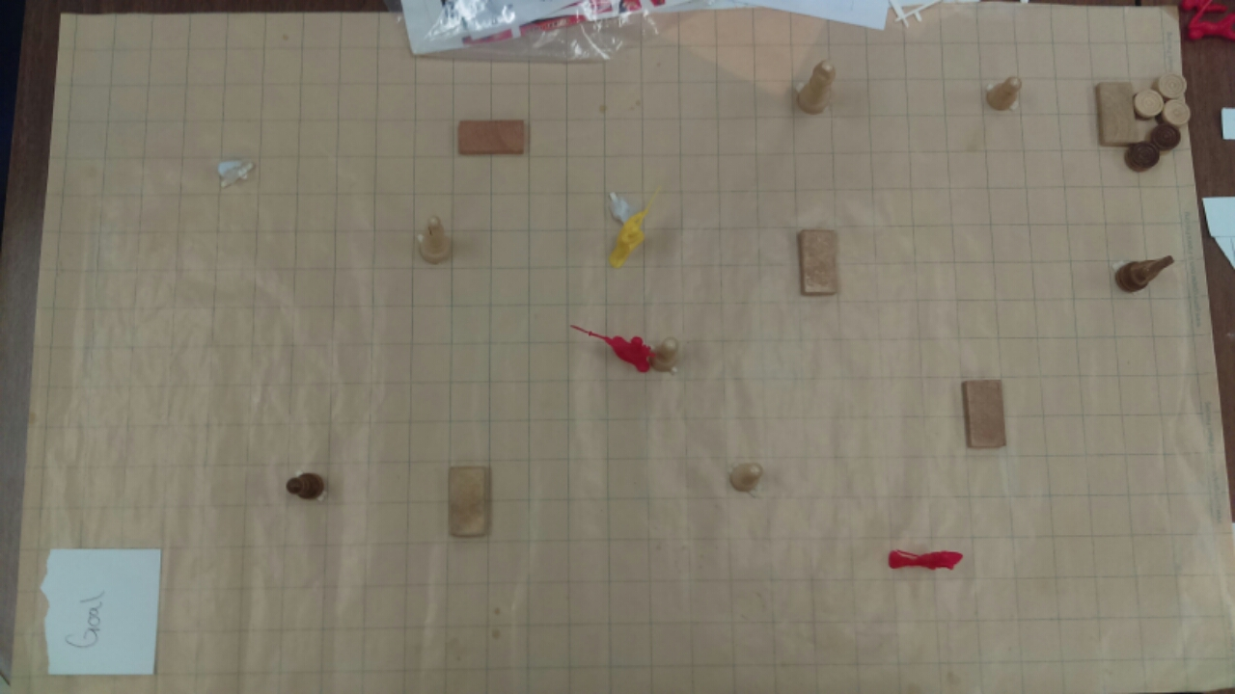
Paper Prototype

Slide 5
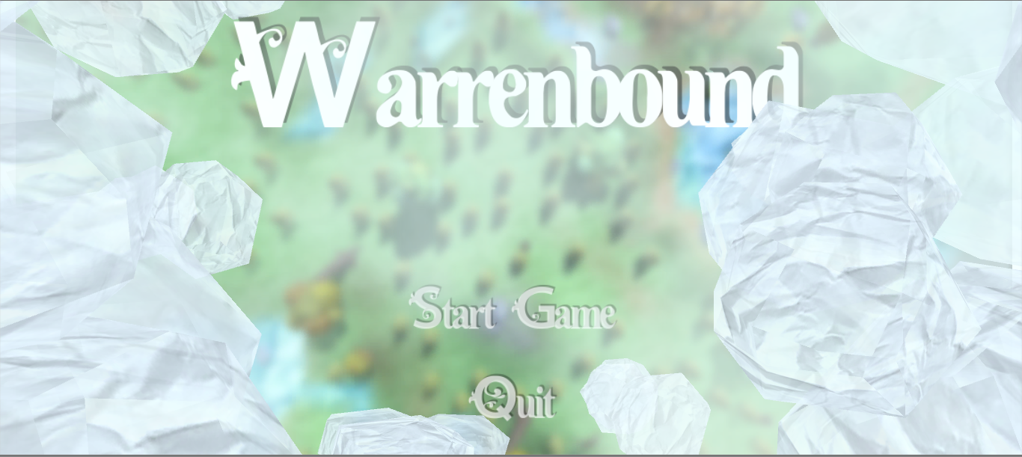

Slide 6
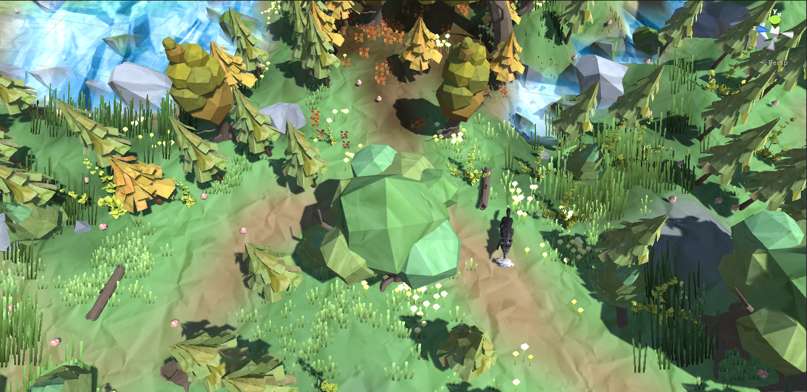

Slide 7
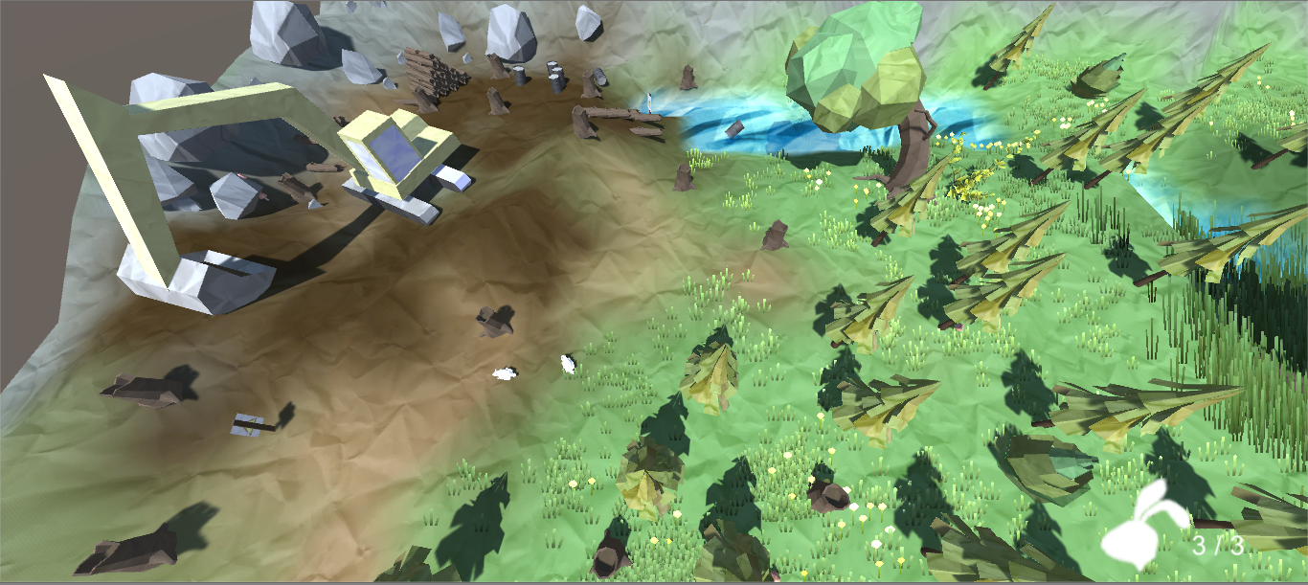

Slide 8
Outside links
https://www.facebook.com/warrenboundgame/

